Slide 1


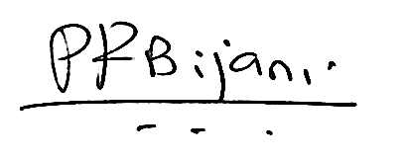
Learning & Development
Certificate of Completion
Kanagamani T
Who has successfully completed the
FSE Accreditation Program - 2023
With all the rights, privileges and honors thereunto appertaining. Given this 26th Oct 2023.
Felix Weitzman
Global Head
HR Operations and Shared Services
Pramod Bijani
Global Delivery Head - DE&DX

